Slide 1
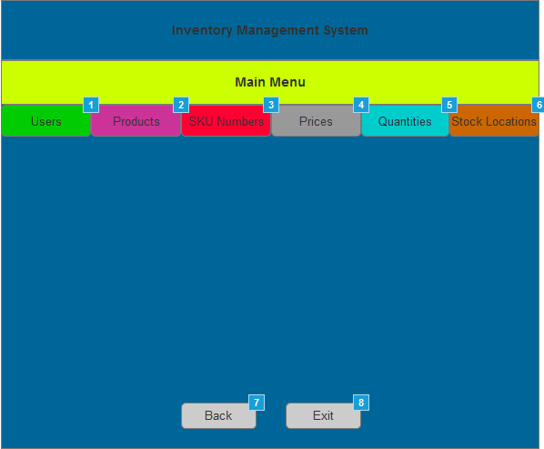

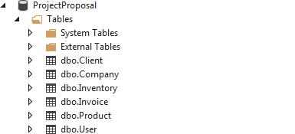
Inventory Management System
Group ABLM
Members:
Ross Monroe
Venance Agnero
Joshua Larson
Sheun Badmus
Description: Inventory Management System is an application designed to manage an inventory system.
Features: User Interface - Database - User Management – Inventory Management – Report Generation
Features description:
User Interface: The user Interface is the interface that allow the user to interact with the system. User will input data to the system and also retrieve data from the system
User Interface design: Main Menu – Similar design for all components
Database: The Database is a structured set of data in the system. It allow users to store data in the system and also retrieve date in the system
Database Design:
https://github.com/SoftwareClassProject/SoftwareProject2.git

Slide 2
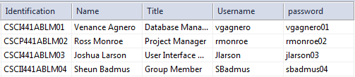
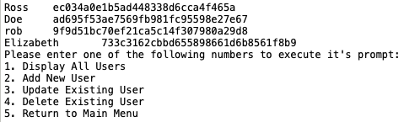
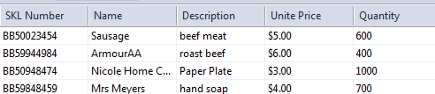
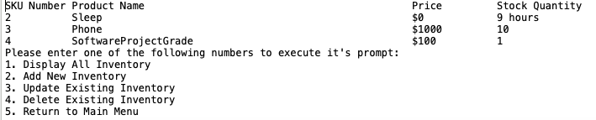
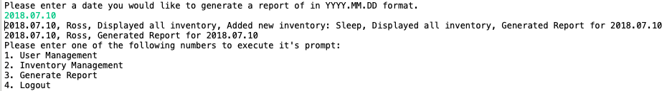
User Management: A feature that allows you to add and delete users of the system, and allows you to update usernames and passwords of existing users. Passwords are encrypted using an encryption algorithm to keep the system and users secure!
Inventory Management: A feature that allows you to see all of the current inventory in the system with their name, price, quantity, and system-generated SKU number. The Inventory Management feature also allows you to add and delete inventory, and allows you to update the name, price, and quantity of an item.
Report Generation: This handy feature tracks a user’s activity within the system and saves it to a report in order to keep track of which user added/deleted/changed something within the system. The system takes that report and saves it by the date it was created.
YouTube: https://www.youtube.com/watch?v=J0w_cGQh8ek
GitHub:
https://github.com/SoftwareClassProject/SoftwareProject2.git

